Slide 1
Test Senior Computer Vision Engineer
Raul Sanchez

Slide 2
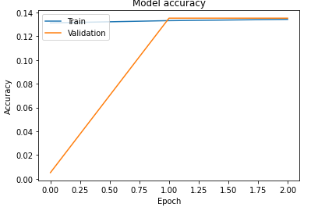
Accuracy Graph

Slide 3
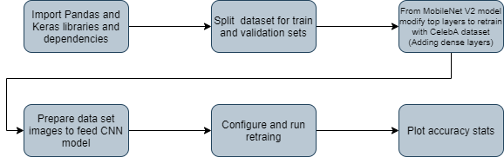
Development sequence

Slide 4
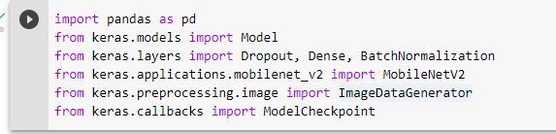
Import Pandas and Keras libraries and dependencies

Slide 5

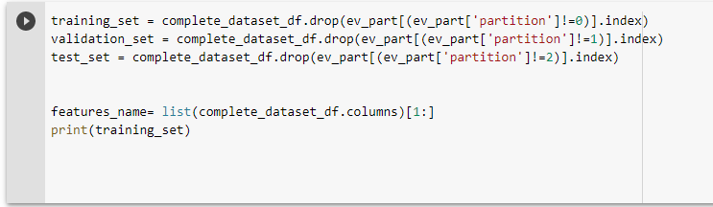
Split dataset for train and validation sets

Slide 6
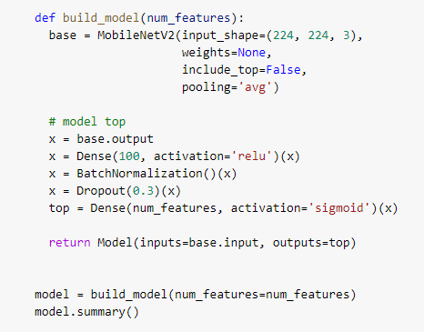

From MobileNet V2 model modify top layers to retrain with CelebA dataset (Adding dense layers)

Slide 7
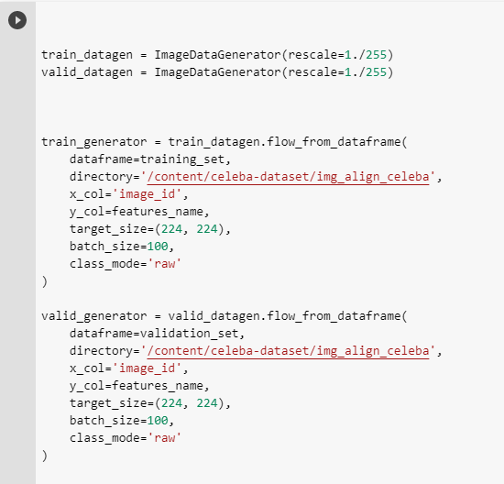
Prepare data set images to feed CNN model

Slide 8
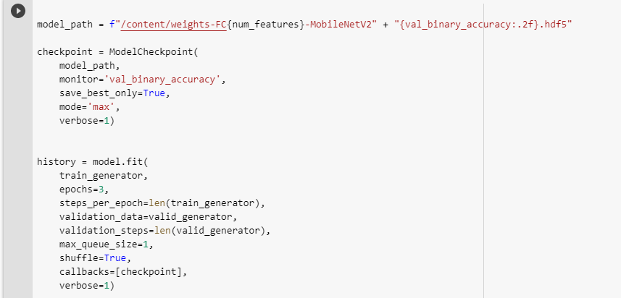
Configure and run retrain

Slide 9
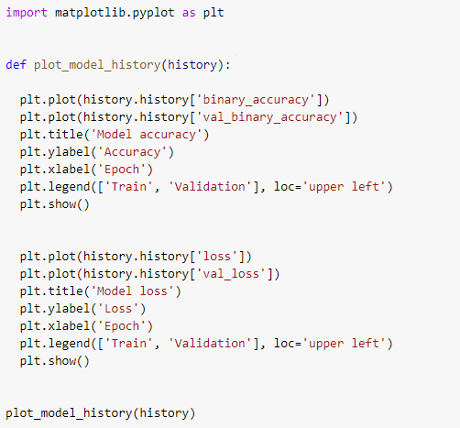
Plot accuracy stats

Slide 10
Considerations
Points to be taken for this test:
Was a intermittent internet connection so I decided to run only 3 epochs for save time and I reduce the dense layer size for save time too. This is the reason for a low accuracy achieved

